Slide 1


FF
Saving food, feeding communities.
Pitch for
FeedForward
28.09.2024
Presented by
TONS OF TECH

Slide 2


FF
Introducing
FeedForward
Connects surplus food with those in need, reducing waste and hunger.
Saving food, feeding communities.

Slide 3
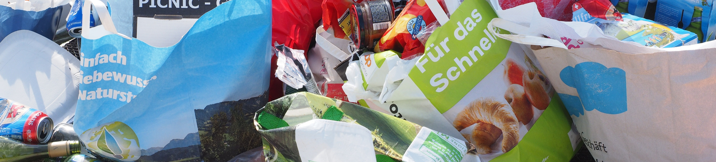
FF
Food wastage remains a critical global issue, with countless edible items discarded daily while many individuals struggle to access basic meals.
Problem
Statement
This disconnect between surplus food from donors and those in need creates a pressing need for an efficient redistribution system. A real-time solution is essential to bridge this gap, ensuring that excess food reaches those who need it most before it goes to waste.

Slide 4
FF
Around 74M+ tonnes foodwaste
Restaurants closed down or downsized operations.
22% of foodgrain output or 10% of total foodgrain and horticulture production, put together, in the country in 2022-23.
The loss accounts for roughly 8% of the total 931 million tonnes of food waste globally.
190M+ Hungry People
India, with a population of 1.4 billion, accounts for one quarter of the world’s undernourished and is home
India is home to an estimated 200 million malnourished people, suggesting widespread food insecurity.

Slide 5




FF
Solutions
Real-Time Food Redistribution Platform
AI-Driven Food Quality Assessment
Volunteer Recognition and Incentives
Feed Forward uses AI to analyze food photos and predict freshness. Volunteers can prioritize delivering perishable items, reducing waste and ensuring food safety for recipients.
To motivate volunteers, Feed Forward includes a reward system. Volunteers earn badges or certificates for their efforts, fostering a sense of accomplishment and community spirit.
Feed Forward connects restaurants, hotels, and event planners with volunteers. Donors can easily share excess food, while volunteers quickly find and deliver it.

Slide 6


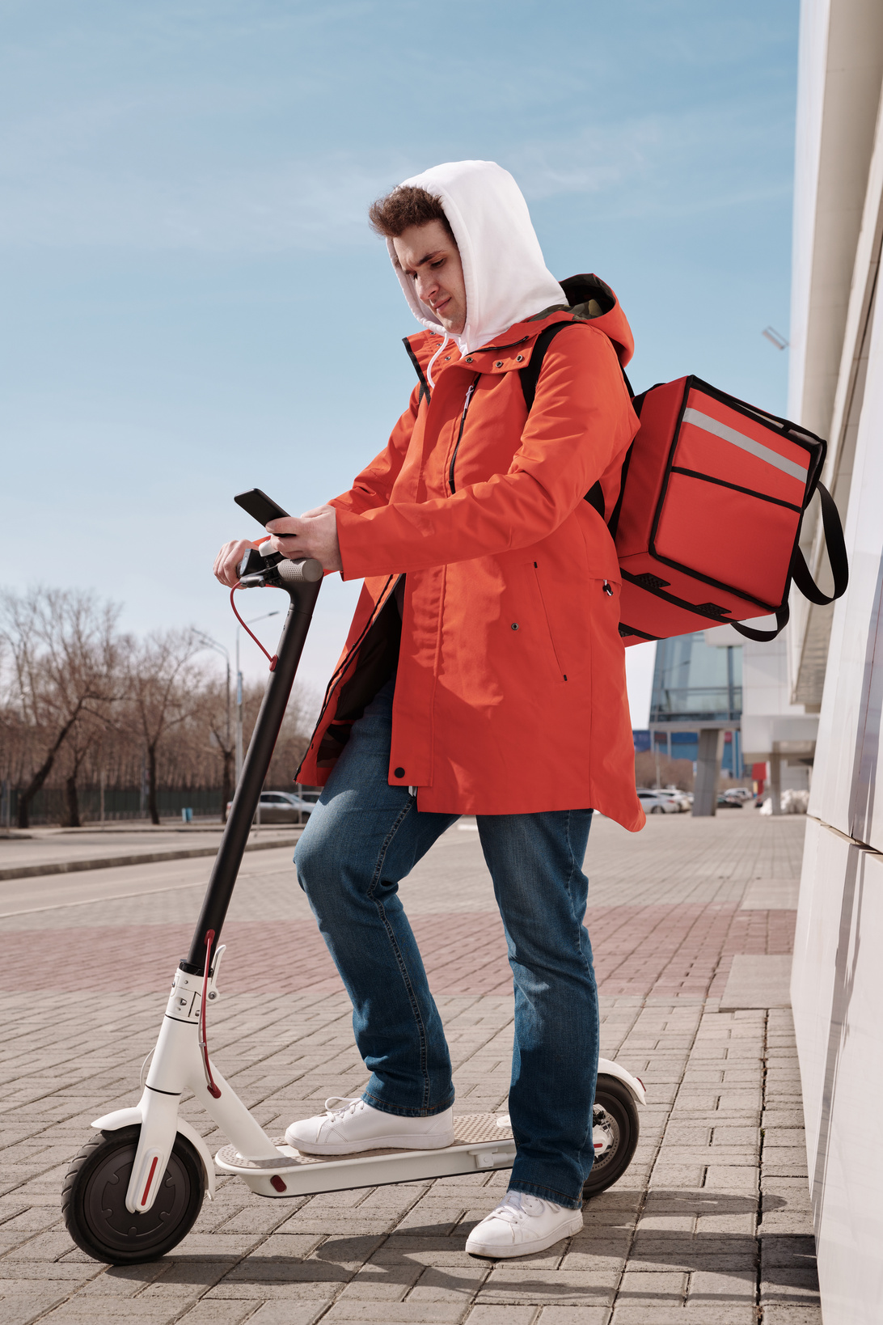
Market Research &Target Audience
FF
1
Food Waste Problem:
1.3 billion tons of food wasted globally each year.
Target Users:
Businesses: Restaurants, hotels, event planners with excess food.
Volunteers: Socially-conscious individuals, non-profits.
2
3
Sustainability Demand:
62% of consumers prefer eco-friendly brands.
Tech-Savvy Audience:
Millennials & Gen Z driven by social impact, likely to adopt tech solutions.
4

Slide 7

FF
What We Can Do
MINIMIZES FOOD WASTE
Reduces surplus food disposal through efficient redistribution.
STRENGTHENS COMMUNITY BONDS
Fosters collaboration between donors, volunteers, and recipients.
ENHANCES FOOD SECURITY: IMPROVES ACCESS TO NUTRITIOUS MEALS FOR THOSE IN NEED.
Collaborate in real-time with teammates. Share tasks and work simultaneously to create a powerful presentation.

Slide 8




FF
Use Cases & Benefits for Target Audience
Conversion Rate
Boosts engagement by connecting donors with volunteers for efficient food redistribution.
Increases completed food donations, reducing waste.
ROI (Return on Investment)
AI-driven food quality prioritizes perishable items for faster delivery.
Optimizes volunteer efforts and boosts system efficiency.
Brand Awareness
Enhances eco-friendly image for participating businesses.
Improves social media engagement and public perception.

Slide 9
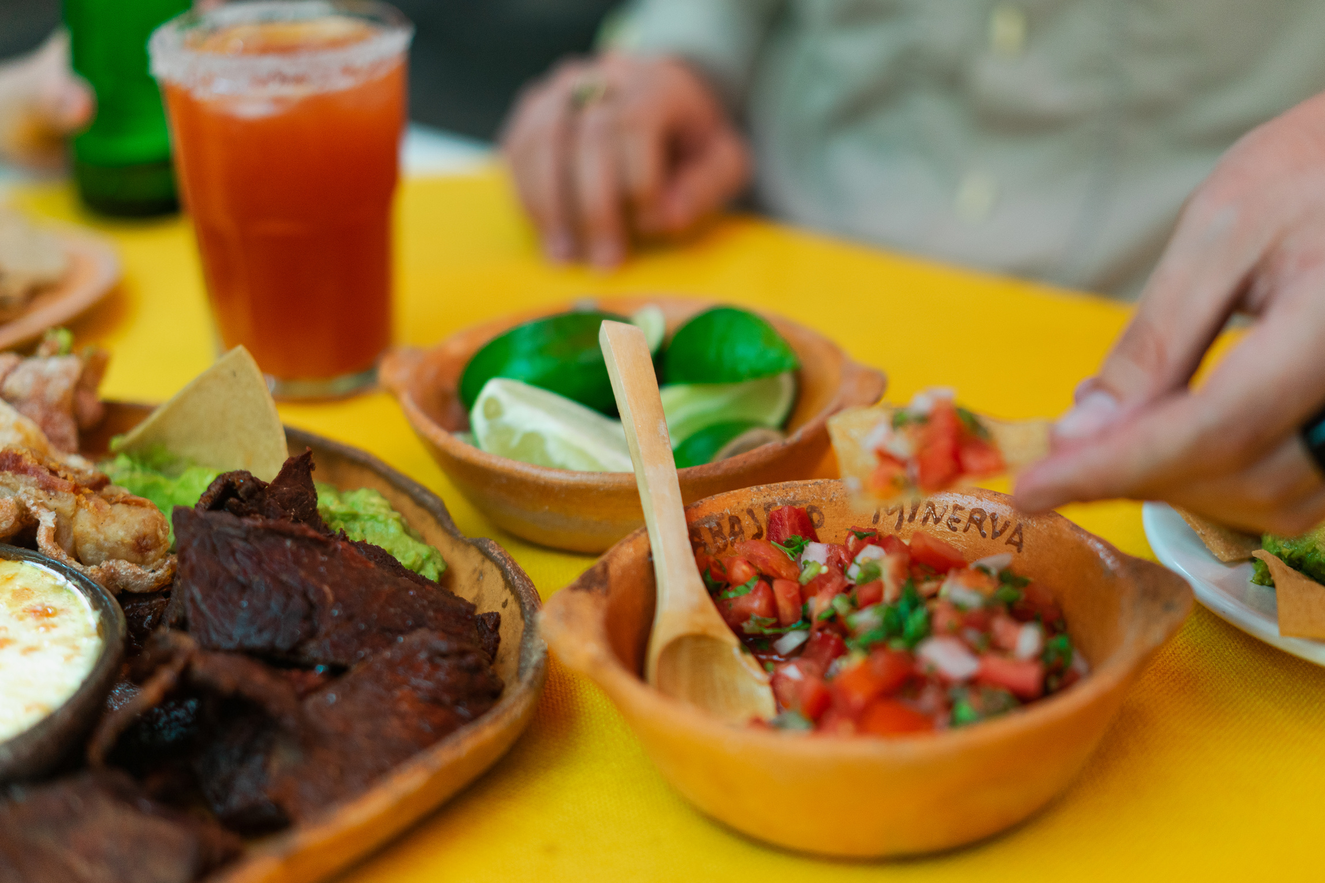

FF
Launch mobile application.
What's
Next for FeedForward
Make our first 50 deliveries.
Integrate more online banking options for payment.
Offer in-app e-wallet option.
We plan to expand and improve our offerings -- and for that, we need your help.
Streamline UI design to better accommodate new features

Slide 10

FF
How the
App Works
FeedForward
Saving food, feeding communities.

